Slide 1

Project 1 -Coffee Shop Analysis
By Jacob Nottingham

Slide 2
Tech Stack Used
Programing Language
Scala version 2.11.12
JRE/JDK version 8.0.311
Database Management System
Spark-core 2.4.8
Spark-SQLl 2.4.8
Spark-Hive 2.4.8
Integrated Development Environment
IntelliJ Community Edition 2021.3.1

Slide 3
Source Material
Programming guidance
Alvin Alexander – connect MySQL to IntelliJ & linking .scala files that share the same package
Geeks For Geeks – Recursive function calling
FreeCodeCamp – Useful MySQL functions
Stack Overflow – Conditionally checking SQL statements in Scala and Regex
Github – Scala & SQL syntax guidence
Data Sources
Used existing data provided
Output from queries -> .csv format for Excel Use

Slide 4
Summary of Future Analysis
Purpose: “Given a set of data, how does beverage availability & variety relate to the sales performance & popularity of each branch?”
Method/Queries:
All-time maximum consumer sales per beverage
Total number of beverages over full region
Total consumer sales per branch
Total availability per branch
Individual beverage sales per branch

Slide 5
Summary of Future Analysis
Findings:
In this example of an annual report, availability/variety is directly correlated to performance of a branch.
Branch 6 is the top performer, with the most popularity and availability of drinks sold
Branch 1 is underperforming, likely due to either being in a location of less demand or due to a supply issue hindering availability of drinks to sell
Solution:
Branch 1 would need to invest in more supplies & equipment to meet demand or invest in a marketing campaign to attract more business.

Slide 7
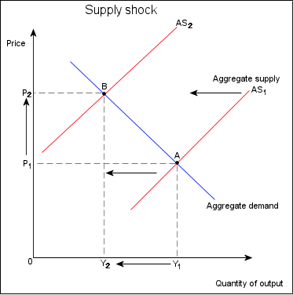
Summary of Future Analysis
Solution Cont.:
Recap - Branch 1 would need to invest in more supplies & equipment to meet demand or invest in a marketing campaign to attract more business.
Disclaimer - Price is not a variable in this future query, but this is a representation of what could potentially happen in a realistic scenario.
assuming that an extraneous factor like a shortage is possibly hindering Branch 1’s inventory.

Slide 8
Tech Demo

Slide 9
Q&A

